Slide 1
CS 188: Artificial Intelligence
Probability
Instructor: Anca Dragan --- University of California, Berkeley
[These slides were created by Dan Klein and Pieter Abbeel for CS188 Intro to AI at UC Berkeley. All CS188 materials are available at http://ai.berkeley.edu.]
Notes:
Please retain proper attribution, including the reference to ai.berkeley.edu. Thanks!

Slide 2
Our Status in CS188
We’re done with Part I Search and Planning!
Part II: Probabilistic Reasoning
Diagnosis
Speech recognition
Tracking objects
Robot mapping
Genetics
Error correcting codes
… lots more!
Part III: Machine Learning
Notes:
Reference AI winter --- logic (exceptions, etc. + so much knowledge --- can learn)
Diagnosis: temperature, blood pressure, types of pain → disease
Speech: temporal signal of pressure variation → words and sentences
Tracking objects: e.g. helicopter you saw in last lecture, combines gps data with accelerometers, gyros and magnetic compass to infer its position and orientation using probabilistic reasoning
Robot mapping: turns out if you put a camera on the helicopter, it would not only be able to fly upside down, but also build a map of the environment!
Genetics: discovery of gene interactions from gene expression data
Error correcting codes: which we use on pretty much all our digital communication lines. They ensure that even in the presence of noise (which is everywhere) we can communicate reliably.
OK: how do we collect all that knowledge in general? --- Part III
Good news: We are going to learn about the tools that got us out of AI winter
The other news: It’s going to get very mathematical! Total shift in gears compared to what we have looked at before.
And yet other news: Time for a fresh start --- which might help if you fell behind in the past weeks.

Slide 3
Today
Probability
Random Variables
Joint and Marginal Distributions
Conditional Distribution
Product Rule, Chain Rule, Bayes’ Rule
Inference
Independence
You’ll need all this stuff A LOT for the next few weeks, so make sure you go over it now!
Notes:
Like “sort this list” or “add these two numbers”

Slide 4

Random Variables
A random variable is some aspect of the world about which we (may) have uncertainty
R = Is it raining?
T = Is it hot or cold?
D = How long will it take to drive to work?
L = Where is the ghost?
We denote random variables with capital letters
Like variables in a CSP, random variables have domains
R in {true, false} (often write as {+r, -r})
T in {hot, cold}
D in [0, ∞)
L in possible locations, maybe {(0,0), (0,1), …}

Slide 5
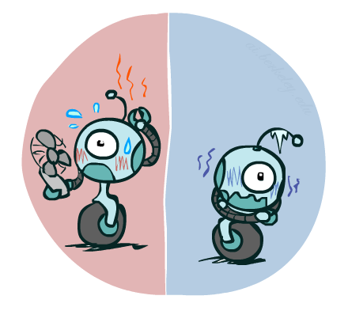

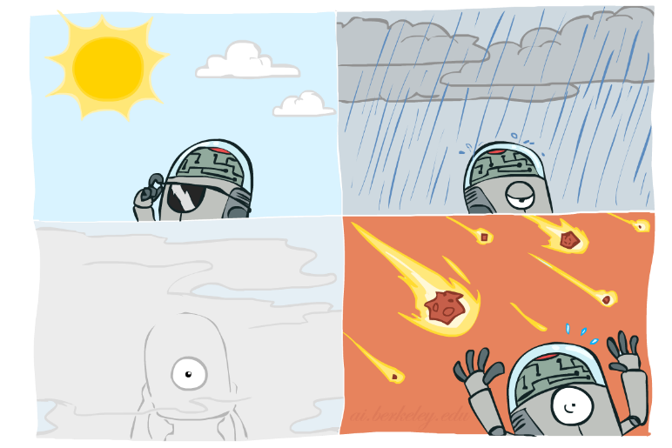

Probability Distributions
Associate a probability with each value
Temperature:
Weather:
W | P
sun | 0.6
rain | 0.1
fog | 0.3
meteor | 0.0
T | P
hot | 0.5
cold | 0.5

Slide 6


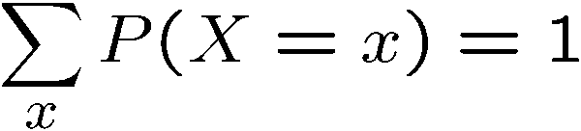
Probability Distributions
Unobserved random variables have distributions
A distribution is a TABLE of probabilities of values
A probability (lower case value) is a single number
Must have: and
Shorthand notation:
OK if all domain entries are unique
T | P
hot | 0.5
cold | 0.5
W | P
sun | 0.6
rain | 0.1
fog | 0.3
meteor | 0.0

Slide 7




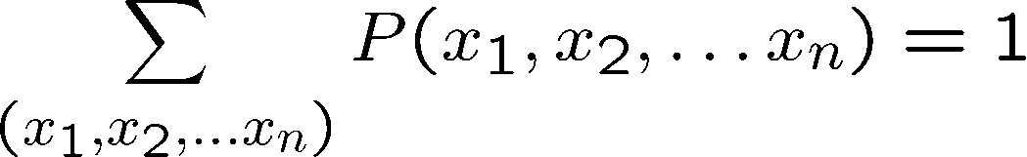
Joint Distributions
A joint distribution over a set of random variables:
specifies a real number for each assignment (or outcome):
Must obey:
Size of distribution if n variables with domain sizes d?
For all but the smallest distributions, impractical to write out!
T | W | P
hot | sun | 0.4
hot | rain | 0.1
cold | sun | 0.2
cold | rain | 0.3

Slide 8
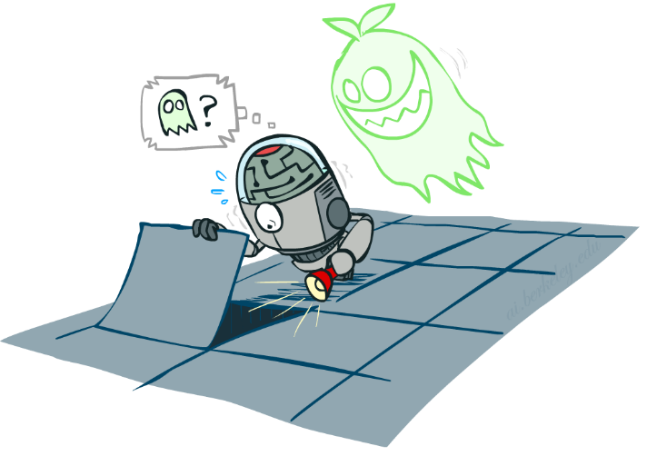

Probabilistic Models
Distribution over T,W
A probabilistic model is a joint distribution over a set of random variables
Probabilistic models:
(Random) variables with domains
Assignments are called outcomes
Joint distributions: say whether assignments (outcomes) are likely
Normalized: sum to 1.0
Ideally: only certain variables directly interact
Constraint satisfaction problems:
Variables with domains
Constraints: state whether assignments are possible
Ideally: only certain variables directly interact
T | W | P
hot | sun | 0.4
hot | rain | 0.1
cold | sun | 0.2
cold | rain | 0.3
Constraint over T,W
T | W | P
hot | sun | T
hot | rain | F
cold | sun | F
cold | rain | T

Slide 9
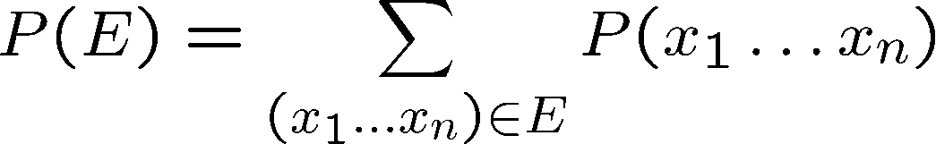
Events
An event is a set E of outcomes
From a joint distribution, we can calculate the probability of any event
Probability that it’s hot AND sunny?
Probability that it’s hot?
Probability that it’s hot OR sunny?
Typically, the events we care about are partial assignments, like P(T=hot)
T | W | P
hot | sun | 0.4
hot | rain | 0.1
cold | sun | 0.2
cold | rain | 0.3

Slide 10

Quiz: Events
P(+x, +y) ?
P(+x) ?
P(-y OR +x) ?
X | Y | P
+x | +y | 0.2
+x | -y | 0.3
-x | +y | 0.4
-x | -y | 0.1

Slide 11
Quiz: Events
P(+x, +y) ?
P(+x) ?
P(-y OR +x) ?
.2
X | Y | P
+x | +y | 0.2
+x | -y | 0.3
-x | +y | 0.4
-x | -y | 0.1
.2+.3=.5
.1+.3+.2=.6

Slide 12
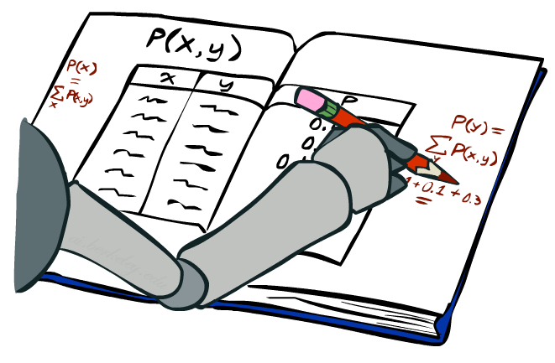
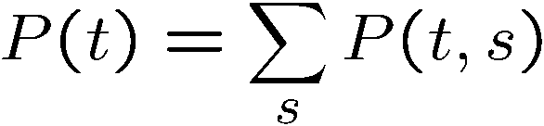
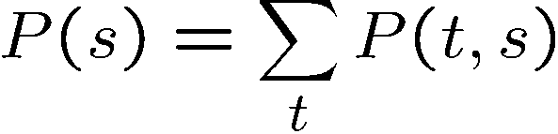
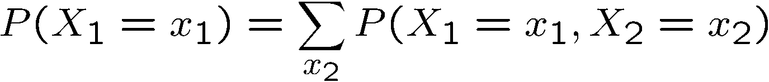
Marginal Distributions
Marginal distributions are sub-tables which eliminate variables
Marginalization (summing out): Combine collapsed rows by adding
T | P
hot | 0.5
cold | 0.5
T | W | P
hot | sun | 0.4
hot | rain | 0.1
cold | sun | 0.2
cold | rain | 0.3
W | P
sun | 0.6
rain | 0.4

Slide 13


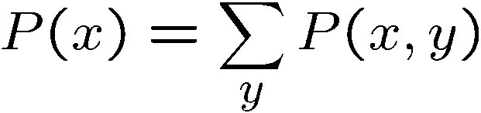

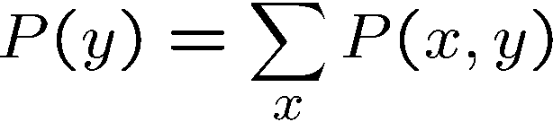
Quiz: Marginal Distributions
X | P
+x
-x
X | Y | P
+x | +y | 0.2
+x | -y | 0.3
-x | +y | 0.4
-x | -y | 0.1
Y | P
+y
-y

Slide 14
Quiz: Marginal Distributions
X | P
+x | .5
-x | .5
X | Y | P
+x | +y | 0.2
+x | -y | 0.3
-x | +y | 0.4
-x | -y | 0.1
Y | P
+y | .6
-y | .4

Slide 15
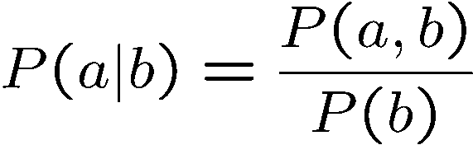
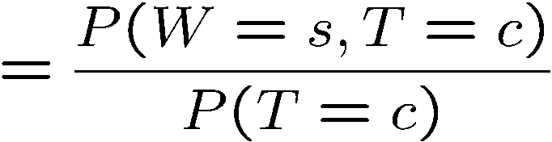
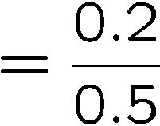



Conditional Probabilities
A simple relation between joint and conditional probabilities
In fact, this is taken as the definition of a conditional probability
P(a,b)
P(a)
P(b)
T | W | P
hot | sun | 0.4
hot | rain | 0.1
cold | sun | 0.2
cold | rain | 0.3

Slide 16
Quiz: Conditional Probabilities
P(+x | +y) ?
P(-x | +y) ?
P(-y | +x) ?
X | Y | P
+x | +y | 0.2
+x | -y | 0.3
-x | +y | 0.4
-x | -y | 0.1

Slide 17
Quiz: Conditional Probabilities
P(+x | +y) ?
P(-x | +y) ?
P(-y | +x) ?
.2/.6=1/3
X | Y | P
+x | +y | 0.2
+x | -y | 0.3
-x | +y | 0.4
-x | -y | 0.1
.4/.6=2/3
.3/.5=.6

Slide 18



Conditional Distributions
Conditional distributions are probability distributions over some variables given fixed values of others
Conditional Distributions
Joint Distribution
W | P
sun | 0.8
rain | 0.2
T | W | P
hot | sun | 0.4
hot | rain | 0.1
cold | sun | 0.2
cold | rain | 0.3
W | P
sun | 0.4
rain | 0.6

Slide 19
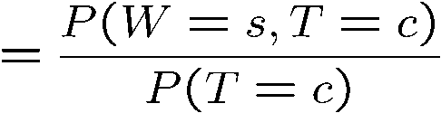

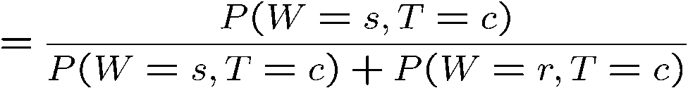
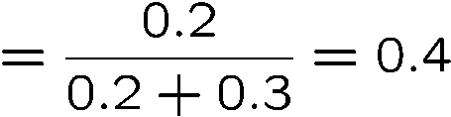

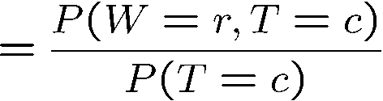

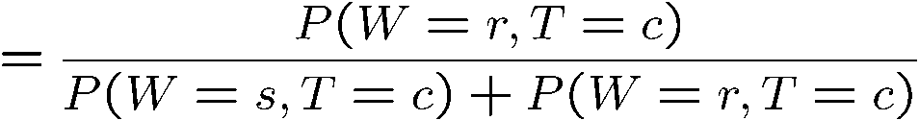
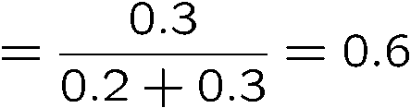
Normalization Trick
T | W | P
hot | sun | 0.4
hot | rain | 0.1
cold | sun | 0.2
cold | rain | 0.3
W | P
sun | 0.4
rain | 0.6

Slide 20

Probabilistic Inference
Probabilistic inference: compute a desired probability from other known probabilities (e.g. conditional from joint)
We generally compute conditional probabilities
P(on time | no reported accidents) = 0.90
These represent the agent’s beliefs given the evidence
Probabilities change with new evidence:
P(on time | no accidents, 5 a.m.) = 0.95
P(on time | no accidents, 5 a.m., raining) = 0.80
Observing new evidence causes beliefs to be updated

Slide 21
Inference by Enumeration
P(W)?
S | T | W | P
summer | hot | sun | 0.30
summer | hot | rain | 0.05
summer | cold | sun | 0.10
summer | cold | rain | 0.05
winter | hot | sun | 0.10
winter | hot | rain | 0.05
winter | cold | sun | 0.15
winter | cold | rain | 0.20

Slide 22
Inference by Enumeration
P(W)?
S | T | W | P
summer | hot | sun | 0.30
summer | hot | rain | 0.05
summer | cold | sun | 0.10
summer | cold | rain | 0.05
winter | hot | sun | 0.10
winter | hot | rain | 0.05
winter | cold | sun | 0.15
winter | cold | rain | 0.20
P(sun)=.3+.1+.1+.15=.65

Slide 23
Inference by Enumeration
P(W)?
S | T | W | P
summer | hot | sun | 0.30
summer | hot | rain | 0.05
summer | cold | sun | 0.10
summer | cold | rain | 0.05
winter | hot | sun | 0.10
winter | hot | rain | 0.05
winter | cold | sun | 0.15
winter | cold | rain | 0.20
P(sun)=.3+.1+.1+.15=.65
P(rain)=1-.65=.35

Slide 24
Inference by Enumeration
P(W | winter, hot)?
S | T | W | P
summer | hot | sun | 0.30
summer | hot | rain | 0.05
summer | cold | sun | 0.10
summer | cold | rain | 0.05
winter | hot | sun | 0.10
winter | hot | rain | 0.05
winter | cold | sun | 0.15
winter | cold | rain | 0.20

Slide 25
Inference by Enumeration
P(W | winter, hot)?
S | T | W | P
summer | hot | sun | 0.30
summer | hot | rain | 0.05
summer | cold | sun | 0.10
summer | cold | rain | 0.05
winter | hot | sun | 0.10
winter | hot | rain | 0.05
winter | cold | sun | 0.15
winter | cold | rain | 0.20

Slide 26
Inference by Enumeration
P(W | winter, hot)?
S | T | W | P
summer | hot | sun | 0.30
summer | hot | rain | 0.05
summer | cold | sun | 0.10
summer | cold | rain | 0.05
winter | hot | sun | 0.10
winter | hot | rain | 0.05
winter | cold | sun | 0.15
winter | cold | rain | 0.20
P(sun|winter,hot)=2/3
P(rain|winter,hot)=1/3

Slide 27
Inference by Enumeration
P(W | winter)?
S | T | W | P
summer | hot | sun | 0.30
summer | hot | rain | 0.05
summer | cold | sun | 0.10
summer | cold | rain | 0.05
winter | hot | sun | 0.10
winter | hot | rain | 0.05
winter | cold | sun | 0.15
winter | cold | rain | 0.20

Slide 28
Inference by Enumeration
P(W | winter)?
S | T | W | P
summer | hot | sun | 0.30
summer | hot | rain | 0.05
summer | cold | sun | 0.10
summer | cold | rain | 0.05
winter | hot | sun | 0.10
winter | hot | rain | 0.05
winter | cold | sun | 0.15
winter | cold | rain | 0.20
P(sun|winter)=.5
P(rain|winter)=.5

Slide 29
Inference by Enumeration
Obvious problems:
Worst-case time complexity O(d^{n})
Space complexity O(d^{n}) to store the joint distribution

Slide 30
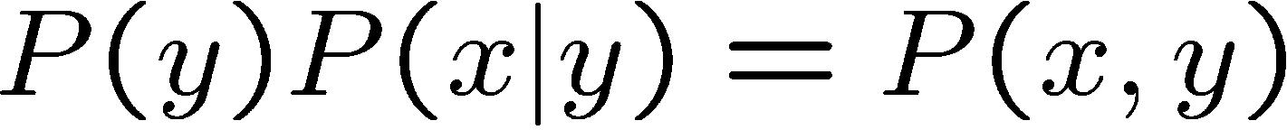
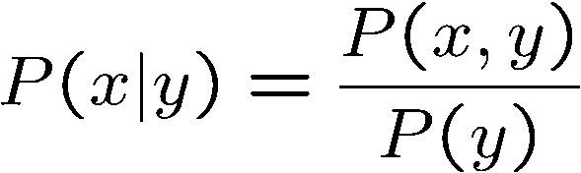
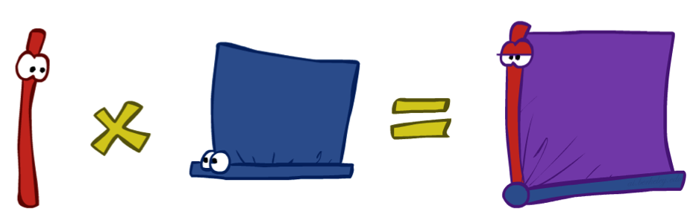
The Product Rule
Sometimes have conditional distributions but want the joint

Slide 31


The Product Rule
Example:
D | W | P
wet | sun | 0.1
dry | sun | 0.9
wet | rain | 0.7
dry | rain | 0.3
D | W | P
wet | sun | 0.08
dry | sun | 0.72
wet | rain | 0.14
dry | rain | 0.06
R | P
sun | 0.8
rain | 0.2

Slide 32
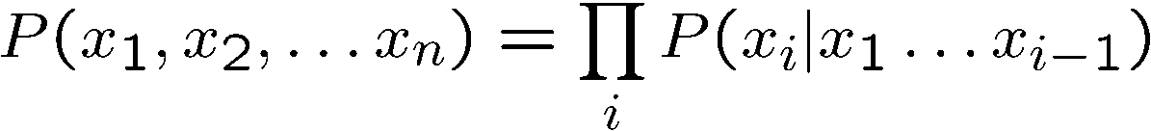
The Chain Rule
More generally, can always write any joint distribution as an incremental product of conditional distributions

Slide 33
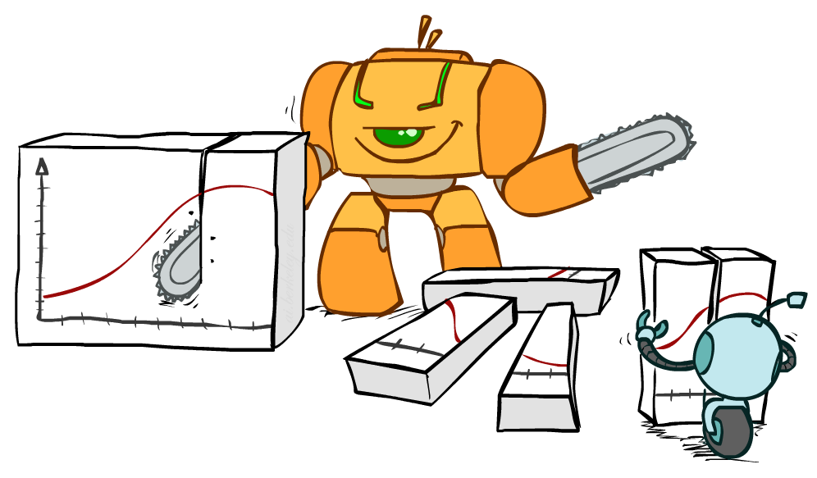
Bayes Rule

Slide 34


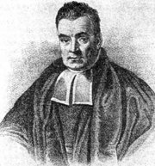
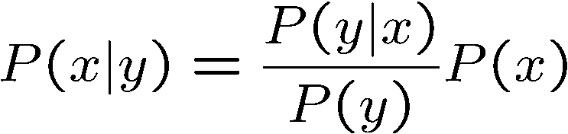
Bayes’ Rule
Two ways to factor a joint distribution over two variables:
Dividing, we get:
Why is this at all helpful?
Lets us build one conditional from its reverse
Often one conditional is tricky but the other one is simple
Foundation of many systems we’ll see later (e.g. ASR, MT)
In the running for most important AI equation!
That’s my rule!

Slide 35
Inference with Bayes’ Rule
Example: Diagnostic probability from causal probability:
Example:
A doctor knows that the disease meningitis causes the patient to have a stiff neck, say, 70% of the time.
The doctor also knows some unconditional facts: the prior probability that a patient has meningitis is 1/50,000,
and the prior probability that any patient has a stiff neck is 1%.
What is the probability that a patient has meningitis when it is known that he has a stiff neck?

Slide 36
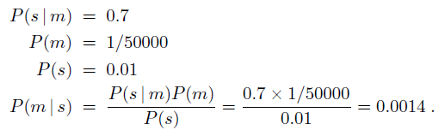
Inference with Bayes’ Rule
A doctor knows that the disease meningitis causes the patient to have a stiff neck, say, 70% of the time.
The doctor also knows some unconditional facts: the prior probability that a patient has meningitis is 1/50,000,
and the prior probability that any patient has a stiff neck is 1%.
What is the probability that a patient has meningitis when it is known that he has a stiff neck?

Slide 37
Inference with Bayes’ Rule
Another Example:
M: meningitis, S: stiff neck
Note: posterior probability of meningitis still very small
Note: you should still get stiff necks checked out! Why?
Example
givens

Slide 38
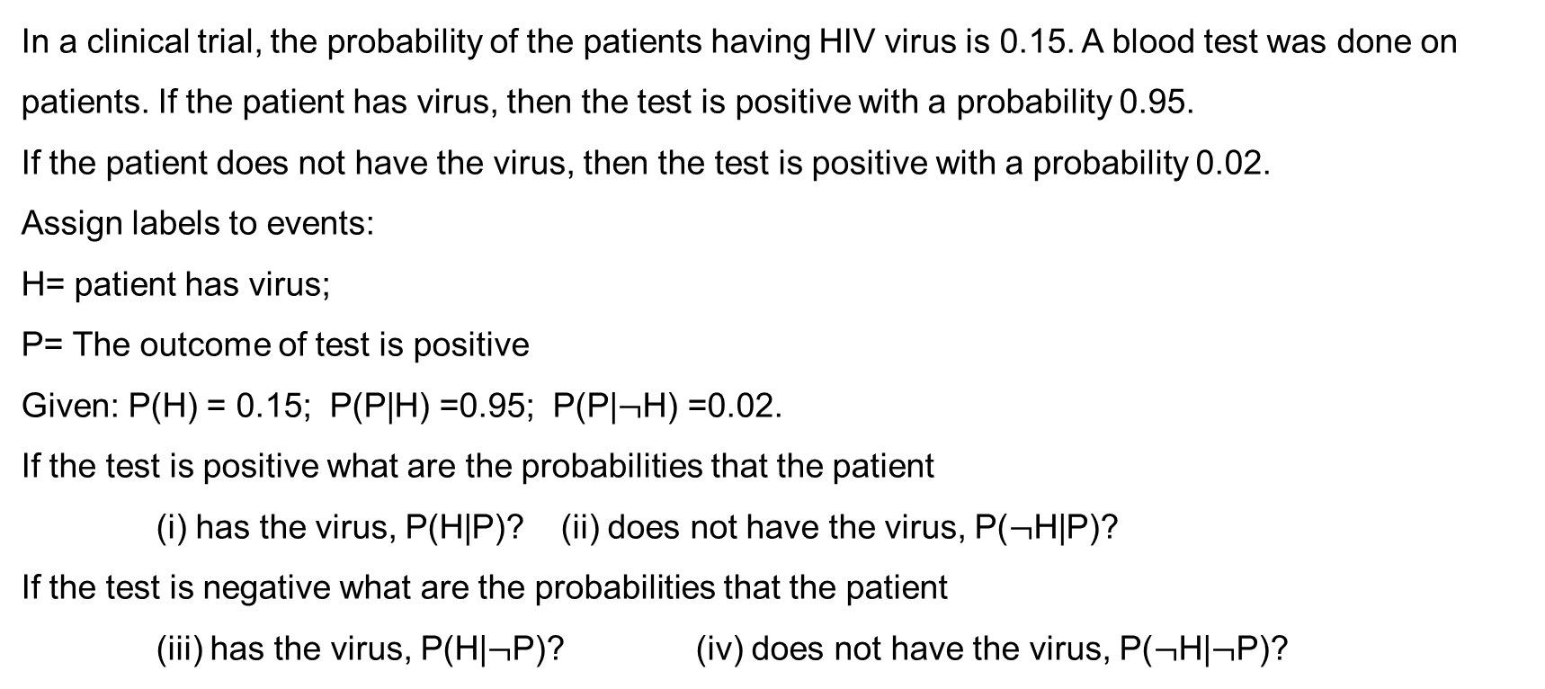
Example: Clinical Trial
In a clinical trial, the probability of the patients having HIV virus is 0.15. A blood test was done on patients. If the patient has virus, then the test is positive with a probability 0.95.
If the patient does not have the virus, then the test is positive with a probability 0.02.
Assign labels to events:
H= patient has virus;
P= The outcome of test is positive
Given: P(H) = 0.15; P(P|H) =0.95; P(P|$¬$H) =0.02.
If the test is positive what are the probabilities that the patient
(i) has the virus, P(H|P)? (ii) does not have the virus, P($¬$H|P)?
If the test is negative what are the probabilities that the patient
(iii) has the virus, P(H|$¬$P)? (iv) does not have the virus, P($¬$H|$¬$P)?

Slide 39
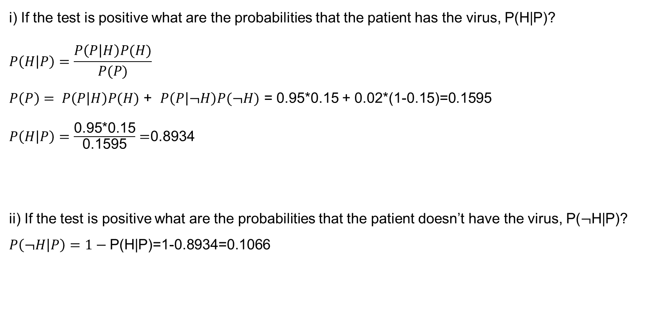
Example: Clinical Trial
i) If the test is positive what are the probabilities that the patient has the virus, P(H|P)?
$$P\left(H | P\right)=\frac{P\left(P | H\right)P(H)}{P(P)}$$
$P\left(P\right)= P\left(P | H\right)P(H)$ + $P\left(P | ¬H\right)P(¬H)$ = 0.95*0.15 + 0.02*(1-0.15)=0.1595
$P\left(H | P\right)=\frac{\text{0.95∗0.15}}{\text{0.1595}}=$0.8934
ii) If the test is positive what are the probabilities that the patient doesn’t have the virus, P($¬$H|P)?
$$P\left(¬H | P\right)=1−\text{P}\text{(}\text{H}\text{|}\text{P}\text{)=1−0.8934=0.1066}$$

Slide 40
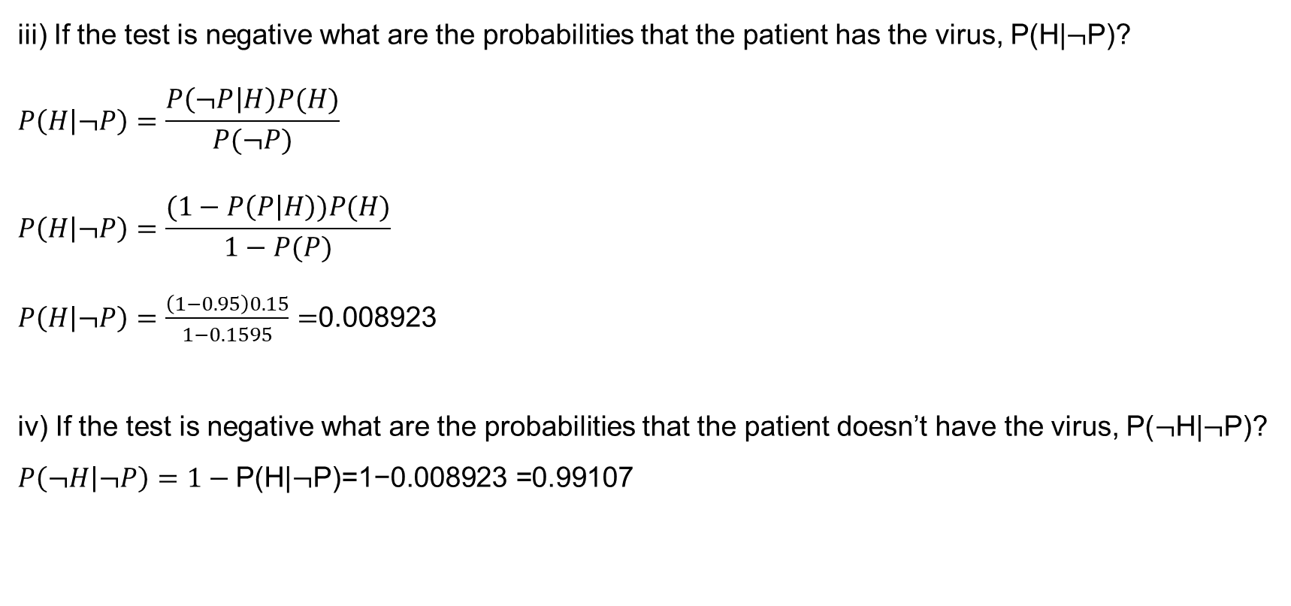
Example: Clinical Trial
iii) If the test is negative what are the probabilities that the patient has the virus, P(H|$¬$P)?
$$P\left(H | ¬P\right)=\frac{P\left(¬P | H\right)P(H)}{P(¬P)}$$
$$P\left(H | ¬P\right)=\frac{(1−P\left(P | H\right))P(H)}{1−P(P)}$$
$P\left(H | ¬P\right)=\frac{\left(1−0.95\right)0.15}{1−0.1595}=$0.008923
iv) If the test is negative what are the probabilities that the patient doesn’t have the virus, P($¬$H|$¬$P)?
$$P\left(¬H | ¬P\right)=1−\text{P}\text{(}\text{H}\text{|}¬\text{P}\text{)=1−0.008923 =0.99}\text{107}$$

Slide 41
Quiz: Bayes’ Rule
Given:
What is P(W | dry) ?
D | W | P
wet | sun | 0.1
dry | sun | 0.9
wet | rain | 0.7
dry | rain | 0.3
R | P
sun | 0.8
rain | 0.2

Slide 42
Quiz: Bayes’ Rule
Given:
What is P(W | dry) ?
D | W | P
wet | sun | 0.1
dry | sun | 0.9
wet | rain | 0.7
dry | rain | 0.3
R | P
sun | 0.8
rain | 0.2
P(sun|dry) ~ P(dry|sun)P(sun) = .9*.8 = .72
P(rain|dry) ~ P(dry|rain)P(rain) = .3*.2 = .06
P(sun|dry)=12/13
P(rain|dry)=1/13

Slide 43
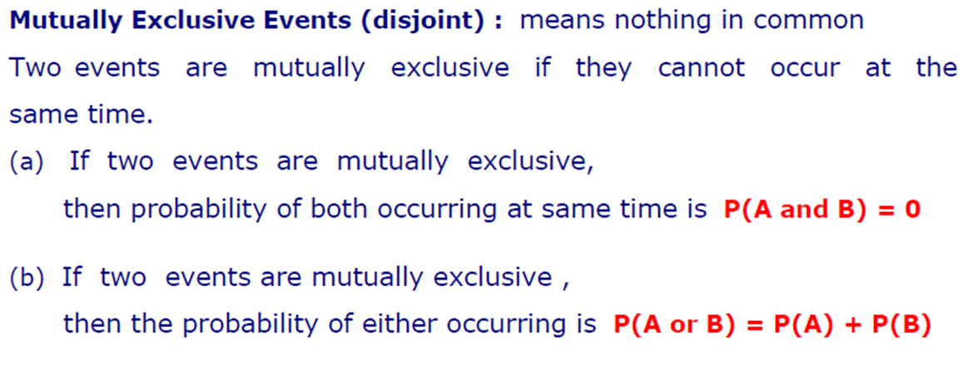
Disjoint Events

Slide 44
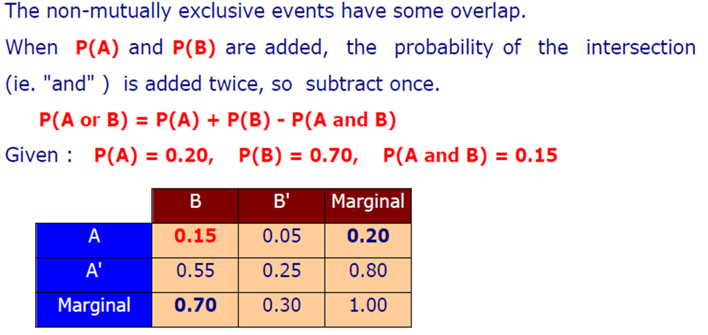
Non-Mutually Exclusive Events

Slide 45

Mutually Exclusive vs Non-Mutually Exclusive Events
Mutually Exclusive
Non-Mutually Exclusive
A
B
A
B
A $∩B$

Slide 46
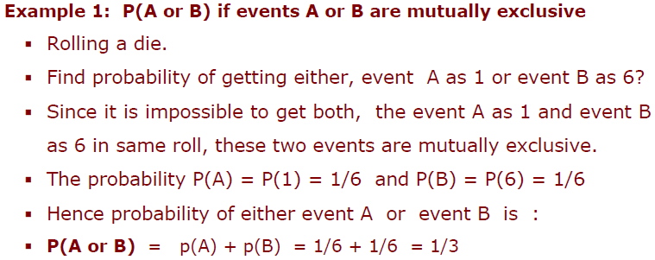
OR Operation: Mutually Exclusive

Slide 47
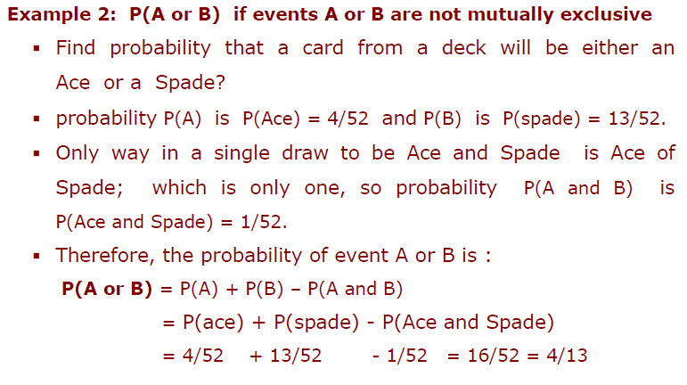
OR Operation: Not Mutually Exclusive

Slide 48
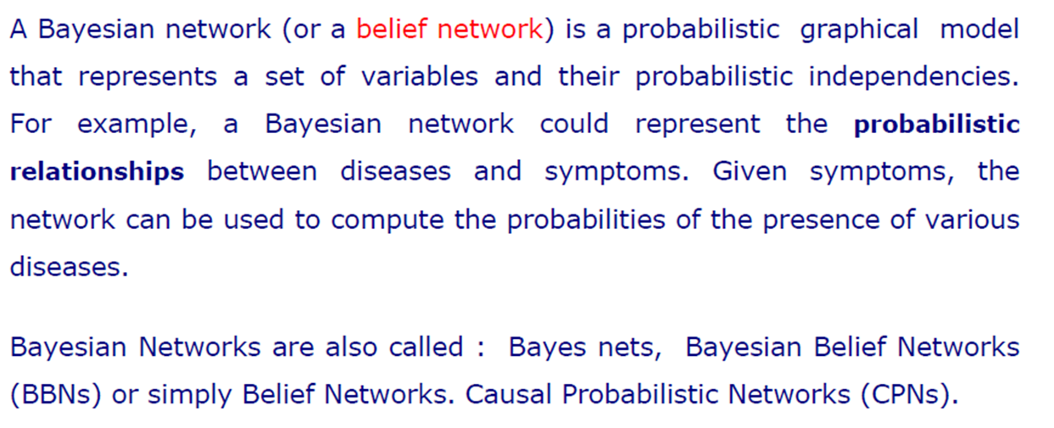
Bayesian Networks

Slide 49
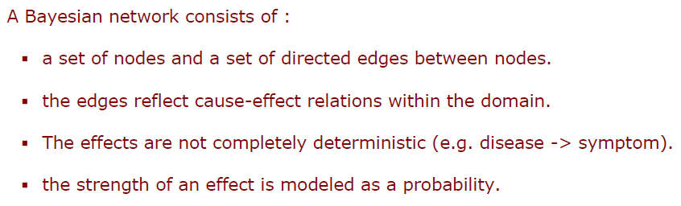
Components of Bayesian Network

Slide 50
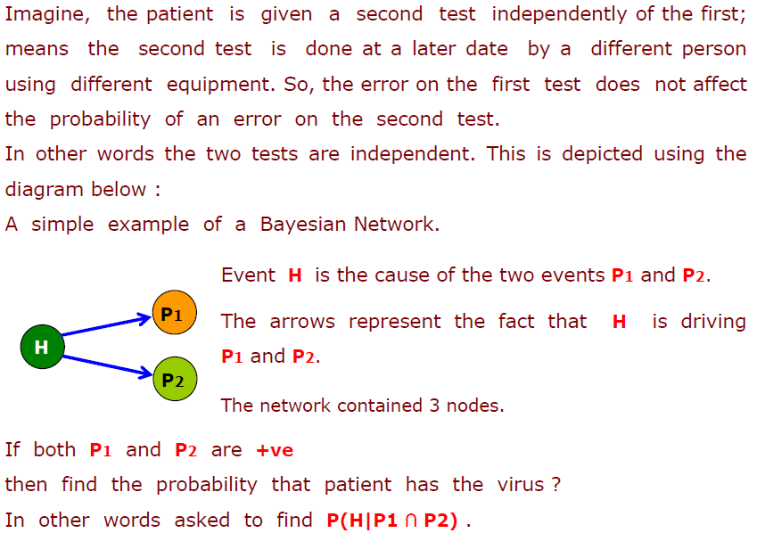
Bayesian Network: Clinical Trial Example

Slide 51
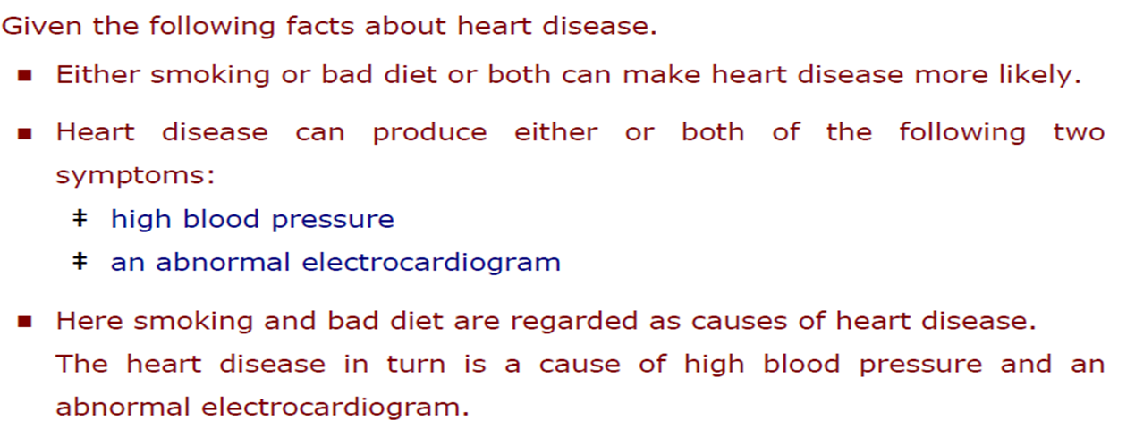
Complicated Bayesian Network

Slide 52
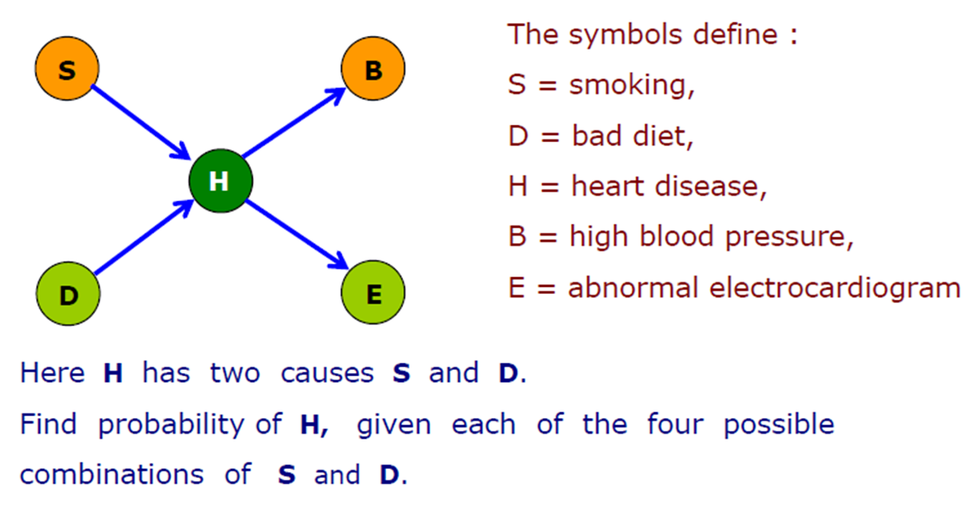
Network of Heart Disease

Slide 53
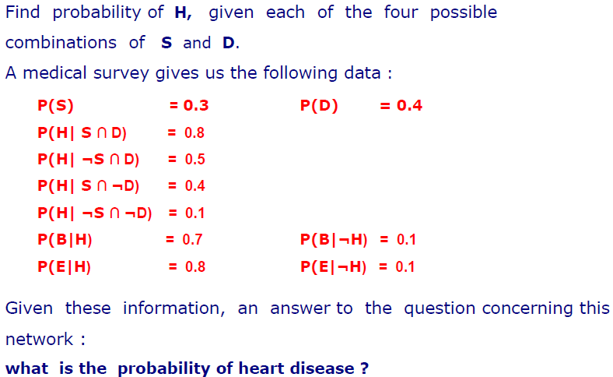
Practice Question

Slide 54
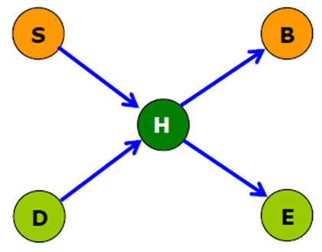
Practice Question
H | P(B=T|H)
T | 0.7
F | 0.1
P(S=T)
0.3
H | P(E=T|H)
T | 0.8
F | 0.1
P(D=T)
0.4
S | D | P(H=T|P,S
T | T | 0.8
F | T | 0.5
T | F | 0.4
F | F | 0.1

Slide 55
Practice Question
In a Bayesian Network if you wish to know the probability that node N, say, is true, you need to look at its parent nodes (i.e. its causes). You need to list all possible combinations of the values of the parent nodes and then consider the probability that N is true for each combination.
In this problem we have to consider all the possible combinations of the two parent nodes S and D. In this case there are four of them, so there are four ways he can have heart disease (H):
He smokes and has bad diet and he has heart disease
He does not smoke and has bad diet and has heart disease
He smokes and does not have bad diet and has heart disease
He does not smoke and does not have bad diet and has heart disease

Slide 56
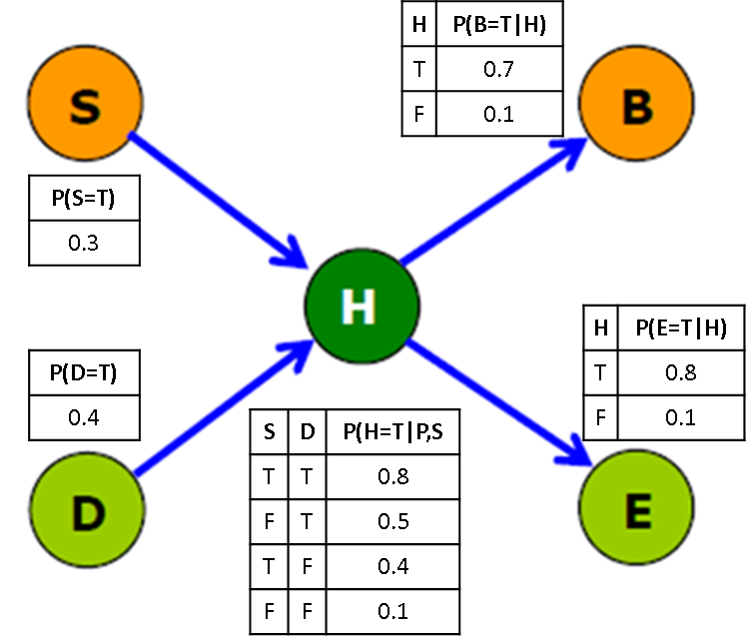
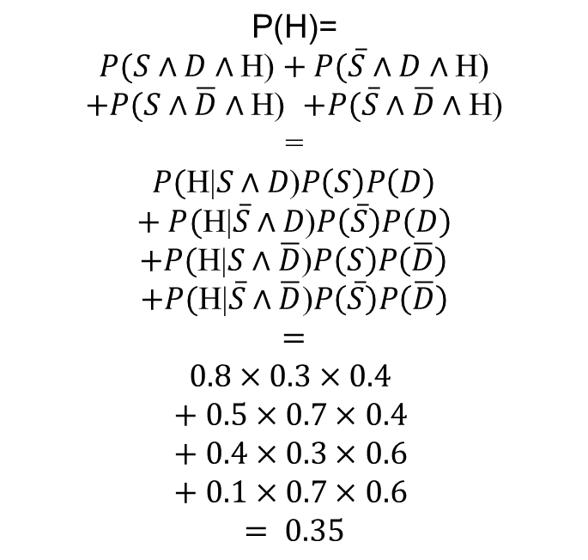
Practice Question
$$\text{P}\text{(}\text{H}\text{)=}$$
$P(S∧D∧\text{H}\text{)}$ $+ P(\overline{S}∧D∧\text{H}\text{)}$
$+P(S∧\overline{D}∧\text{H}\text{)}$ $+P(\overline{S}∧\overline{D}∧\text{H}\text{)}$
=
$P(\text{H}\text{|}S∧D\text{)}P\left(S\right)P\left(D\right)$
$$+ P(\text{H}\text{|}\overline{S}∧D\text{)}P\left(\overline{S}\right)P\left(D\right)$$
$+P(\text{H}\text{|}S∧\overline{D}\text{)}P\left(S\right)P\left(\overline{D}\right)$
$$+P(\text{H}\text{|}\overline{S}∧\overline{D}\text{)}P\left(\overline{S}\right)P\left(\overline{D}\right)$$
$$=$$
$$0.8×0.3×0.4$$
$$+ 0.5×0.7×0.4$$
$$+ 0.4×0.3×0.6$$
$$+ 0.1×0.7×0.6$$
$$= 0.35$$

Slide 57
Practice Question
Suppose we wish to know the probability of heart disease and smoking, i.e. you are told that a patient smokes and has heart disease, but you do not know whether he has bad diet or not. There are two ways in which a patient could have heart disease and smoke: they are
He smokes and has bad diet and he has heart disease
He smokes and does not have bad diet and has heart disease

Slide 58

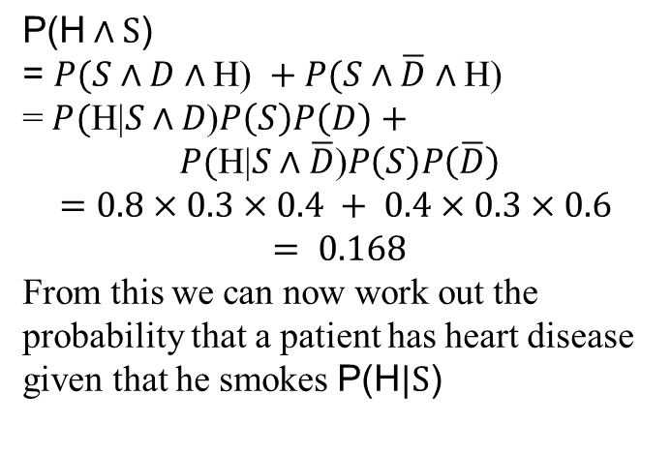
Practice Question
$$\text{P}\text{(}\text{H}∧\text{S}\text{)}$$
$\text{=}$ $P(S∧D∧\text{H}\text{) }+P(S∧\overline{D}∧\text{H}\text{)}$
= $P(\text{H}\text{|}S∧D\text{)}P\left(S\right)P\left(D\right)$ $+$
$P(\text{H}\text{|}S∧\overline{D}\text{)}P\left(S\right)P\left(\overline{D}\right)$
$$=0.8×0.3×0.4 + 0.4×0.3×0.6$$
$$= 0.168$$
From this we can now work out the probability that a patient has heart disease given that he smokes $\text{P}\text{(}\text{H}|\text{S}\text{)}$

Slide 59
Practice Question
Suppose we wish to know the probability of having an abnormal electrocardiogram (ECG) given that a patient smokes, i.e. you are told a patient smokes, but you do not know whether he has bad diet or whether he has heart disease.
An abnormal ECG is caused by H heart disease which is in turn caused by smoking S. So, we have a chain of cause and effect. But we do not know the value of the middle link H in this chain. So, we have to consider each possible value of H as follows
He smokes and has heart disease and has abnormal ECG
He smokes and does not have heart disease and has abnormal ECG

Slide 60
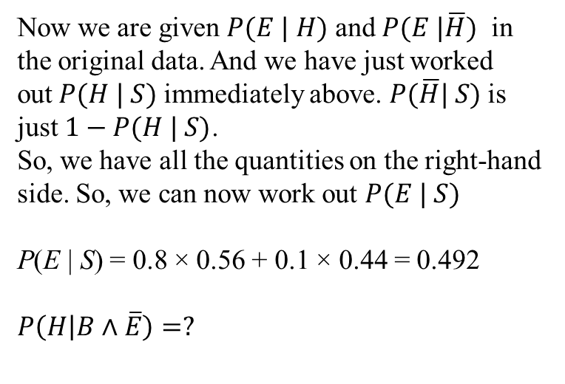
Practice Question
We have to work out the probabilities of each case
Now we are given $P(E | H)$ and $P(E |\overline{H})$ in the original data. And we have just worked out$P(H | S)$immediately above. $P(\overline{H}| S)$is just $1−P(H | S)$.
So, we have all the quantities on the right-hand side. So, we can now work out $P(E | S)$
P(E | S) = 0.8 × 0.56 + 0.1 × 0.44 = 0.492
$$P\left(H | B∧\overline{E}\right)=?$$

